Slide 1
David’s Property Management Website
Team:
Jake Bradford n9190007
Ricky Phan n9562982
Michael de Closey n9165924
Jason Trapp n8828512
Phuoc Nguyen n9173609
rocky-tor-80049.herokuapp.com/home.php

Slide 2
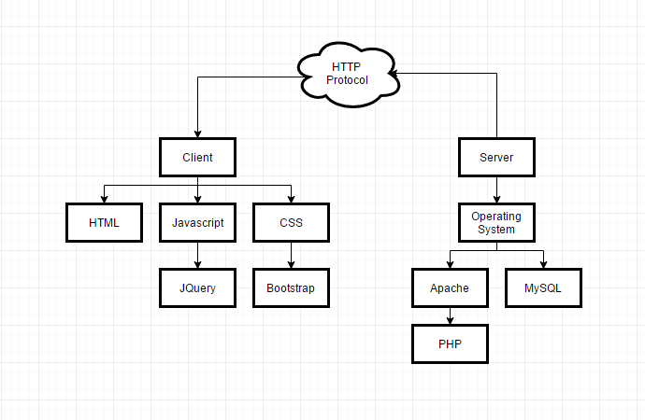
System Architecture

Slide 3
System Architecture
Heroku –free, easy to deploy for applications and connects with GitHub
PHP – for server-side requests
MySQL – to store data
JavaScript – to perform non-server related tasks
HTML – webpage structure
CSS – webpage styling

Slide 4
Sprint 1 Release: Part
Database:
Search results come from data stored internally into the websites system.
Story dependencies
S5 Tenant Details Storage
S6 Staff Details Storage
S9 Contract Details Storage
S11 Owner Details Storage

Slide 5
5
Tenant Details Storage
Could
2
•As a staff member I need to be able to save all the tenants details so that I can review tenants later
Acceptance Criteria
Website records tenant account details
Webpage displays tenant details
Cannot record the same tenant twice
Required fields can’t be blank
Notes

Slide 6
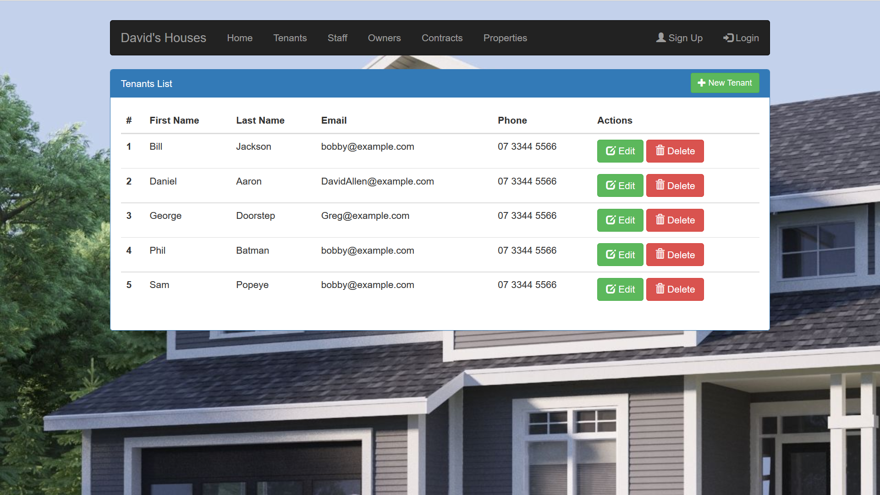

Slide 7
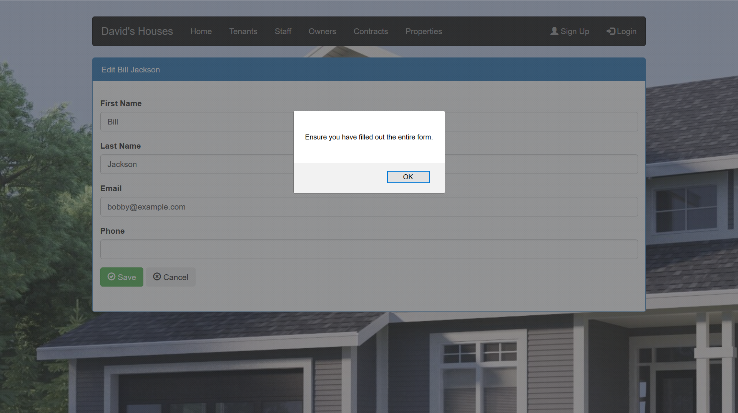

Slide 8
6
Staff Details Storage
Must
2
•As David, I want to record the details of staff so that I can review their details later
Acceptance Criteria
Website records Staff details
Webpage displays Staff details
Staff can’t access personal records
Required fields can’t be blank
Notes

Slide 9
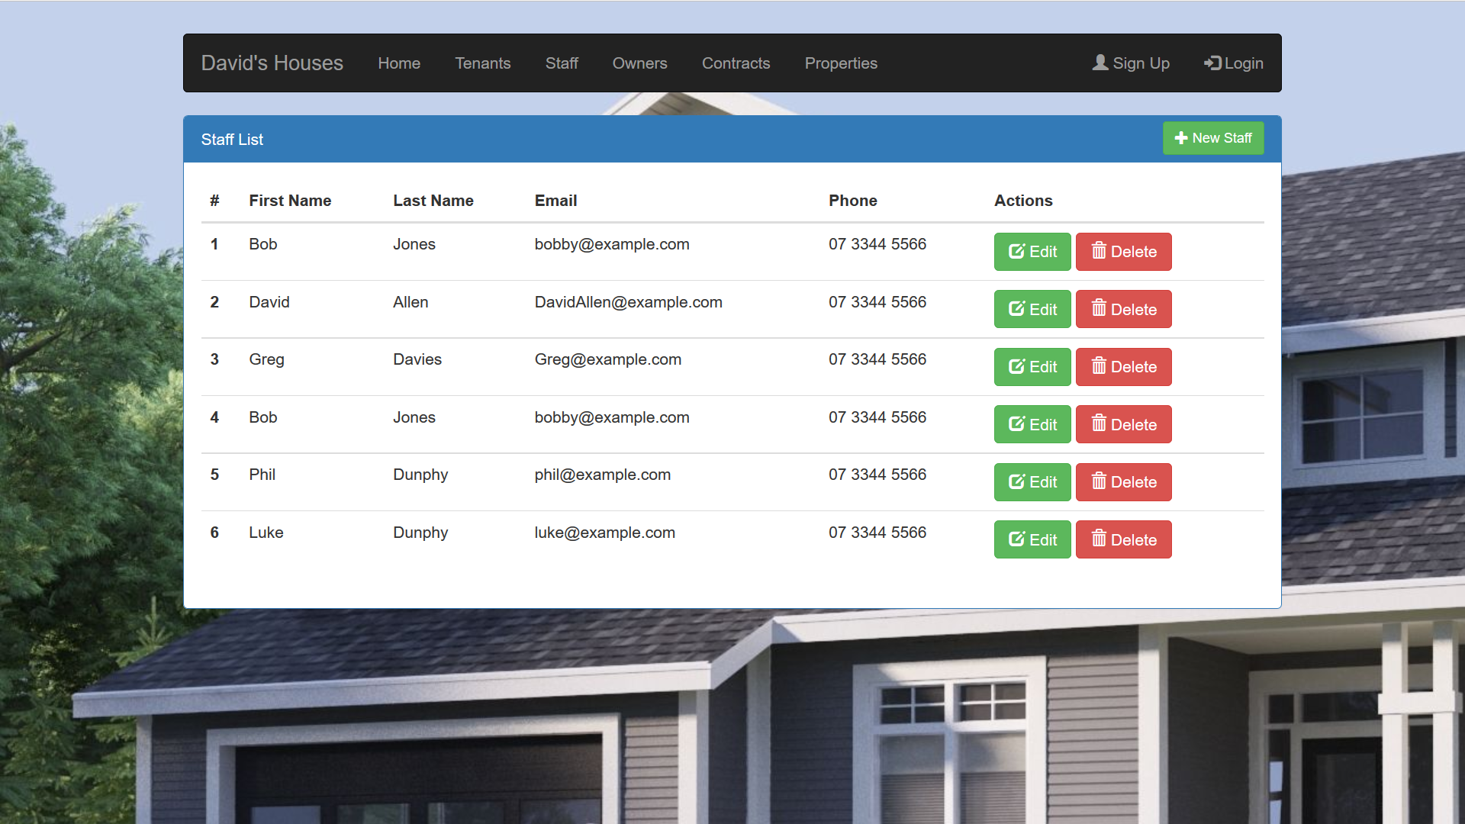

Slide 10
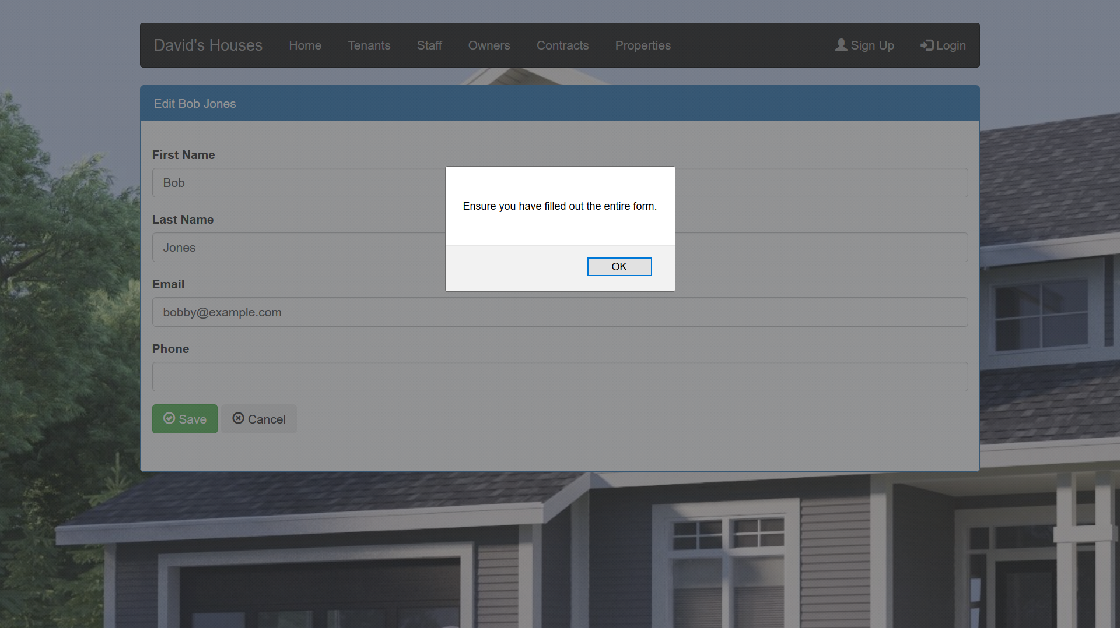

Slide 11
9
Contract detail storage
Must
2
•As a staff member, I need to be able to record contract details so that I can lease properties to a prospective tenant
Acceptance Criteria
Website records contract details
Website displays contract details
Required fields can’t be blank
Only staff can record details
Notes

Slide 12
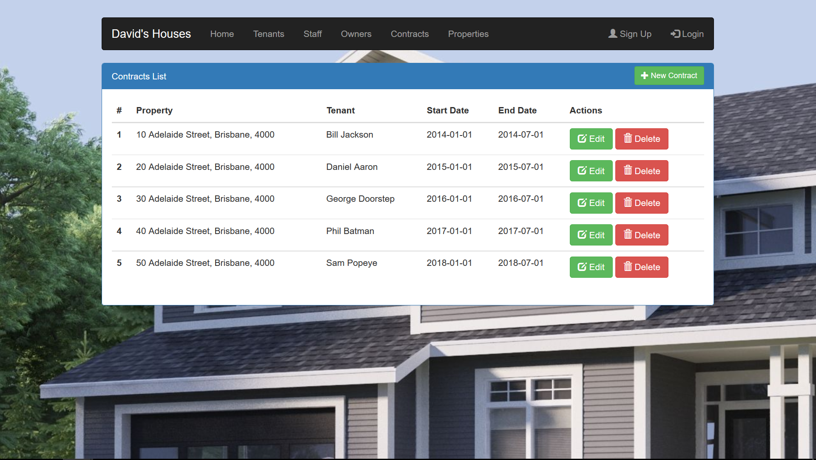

Slide 13
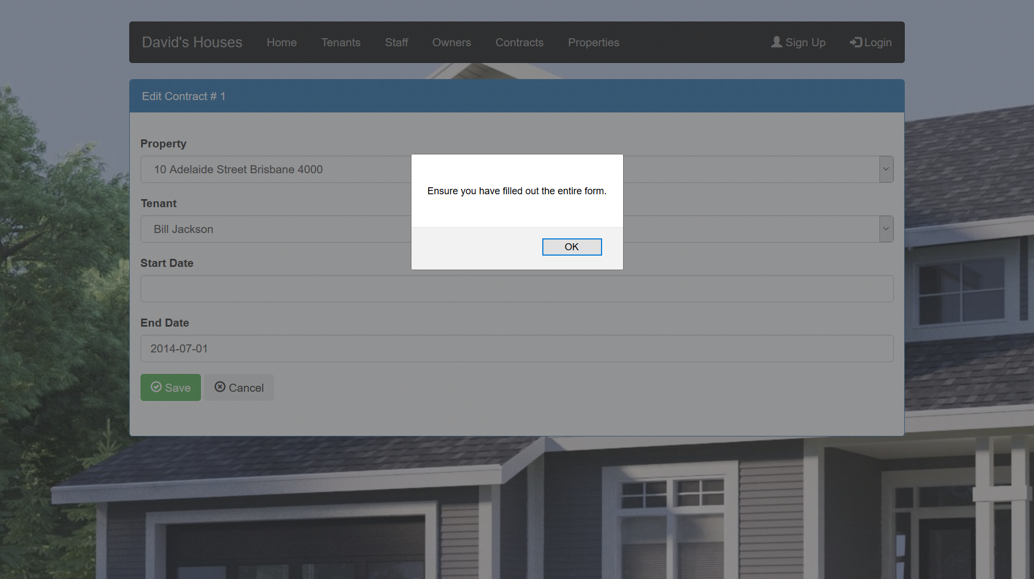

Slide 14
11
Owner detail storage
Should
4
•As David, I can enter the details of property owners so that I can review their details later
Acceptance Criteria
Property owner details visible
Website records property owner details
Only David can enter details
Required fields can’t be blank
Notes

Slide 15
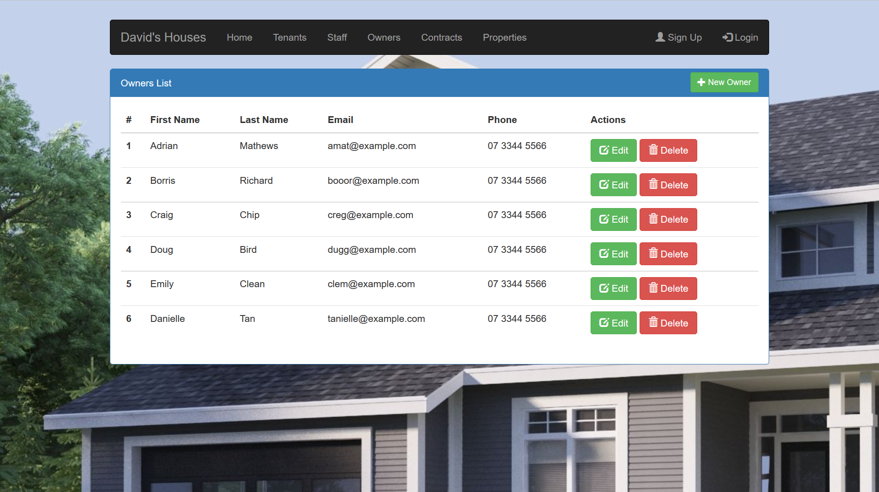

Slide 16
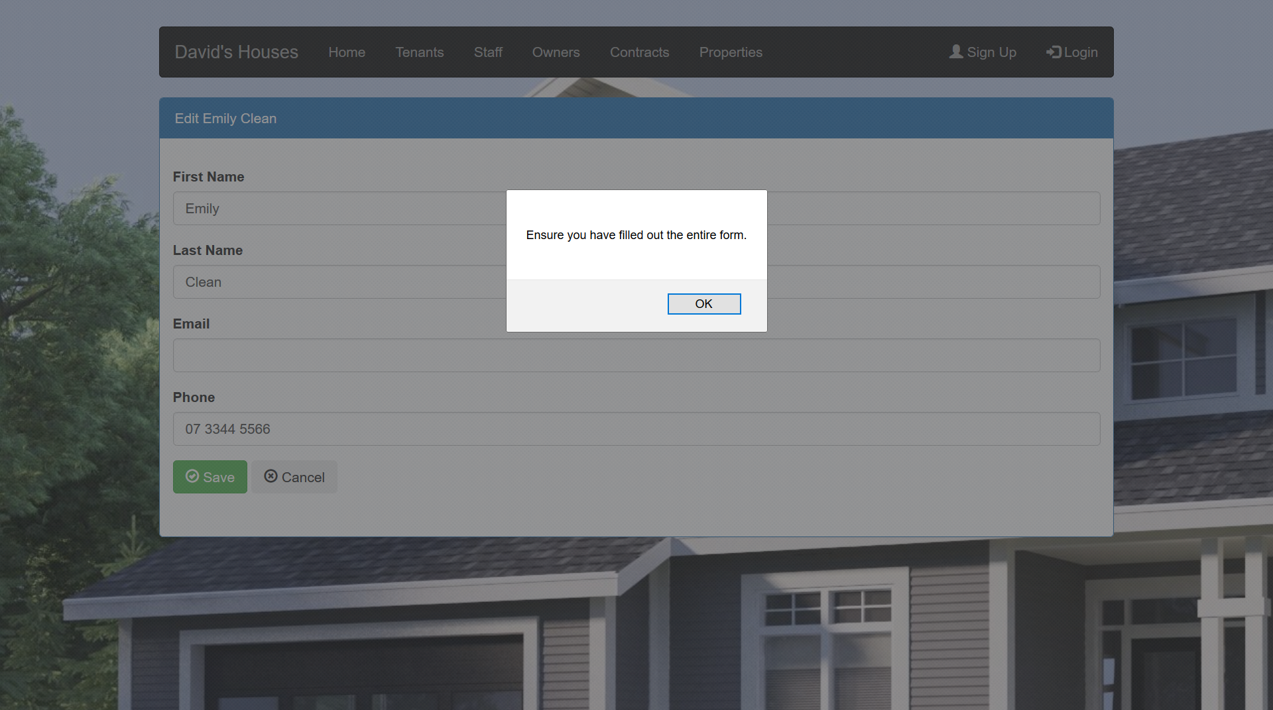

Slide 17
Sprint 1 Release: Part 2
Searching:
Users can search for properties using keywords
Story dependencies
S2 Property Search
S3 Viewing Times

Slide 18
2
Property Search
Could
1
•As a prospective tenant I need to be able to search for properties so that I can find properties I may want to live in
Acceptance Criteria
Visible search bar
Search produces results page
Page displays error if invalid search
Notes

Slide 19
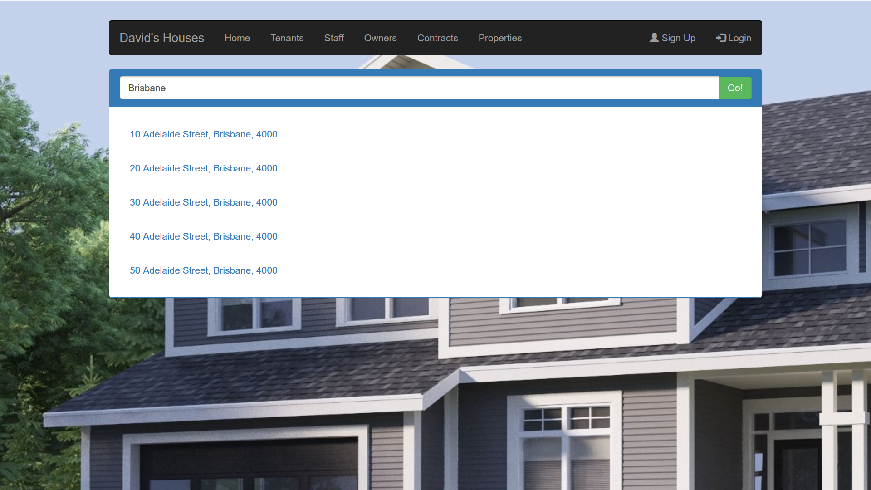

Slide 20
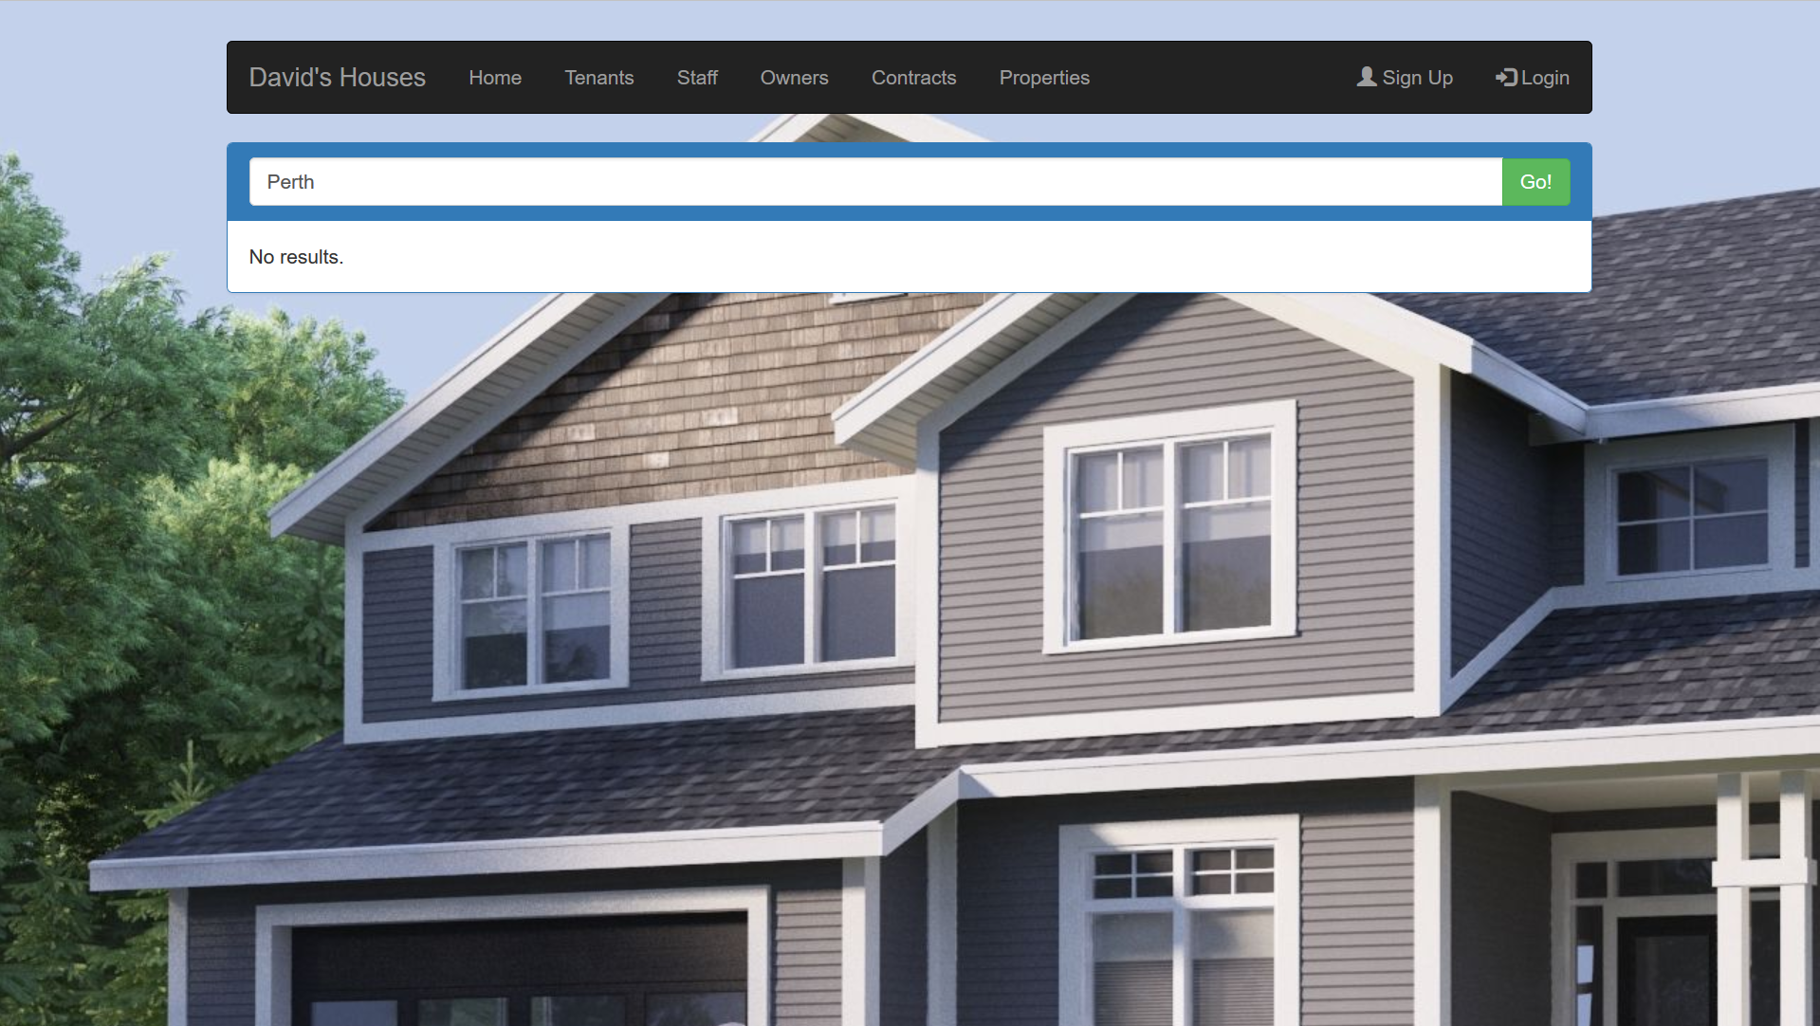

Slide 21
3
Viewing Times
Must
2
•As Staff I need to set a date and time for property viewings so that prospective tenants can visit properties
Acceptance Criteria
Visible inspection times
Times can be set by staff
Times can be changed by staff
Blank if no time set
Notes

Slide 22
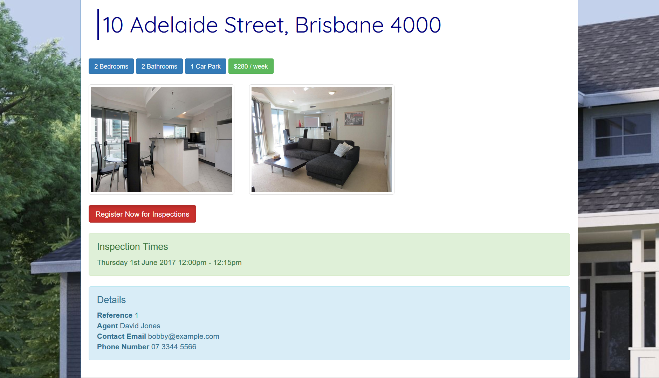

Slide 23
Sprint 2 Release: Part 1
Property Displays:
Property Information from requirements displayed and searchable
Story Dependencies:
S1 Property ID Reference
S4 Property Inspection Request
S14 Property Photo Gallery

Slide 24
1
Property ID reference
Could
2
•As a prospective tenant I need to see a property ID to reference when contacting David via Gumtree
Acceptance Criteria
Property ID input produces respective property webpage
Property ID visible for all properties
Property ID is unique to each property
Property ID can’t be blank
Notes

Slide 26
4
Property inspection registration
Could
4
•As a prospective tenant I need to be able to register for a property viewing on a given day/time so I can visit a property I may want to live in
Acceptance Criteria
Registration available on property page
Website stores registration details
Notify user if viewing time is unavailable
Notes
Staff should be able to see a list of current users registered for an inspection

Slide 27
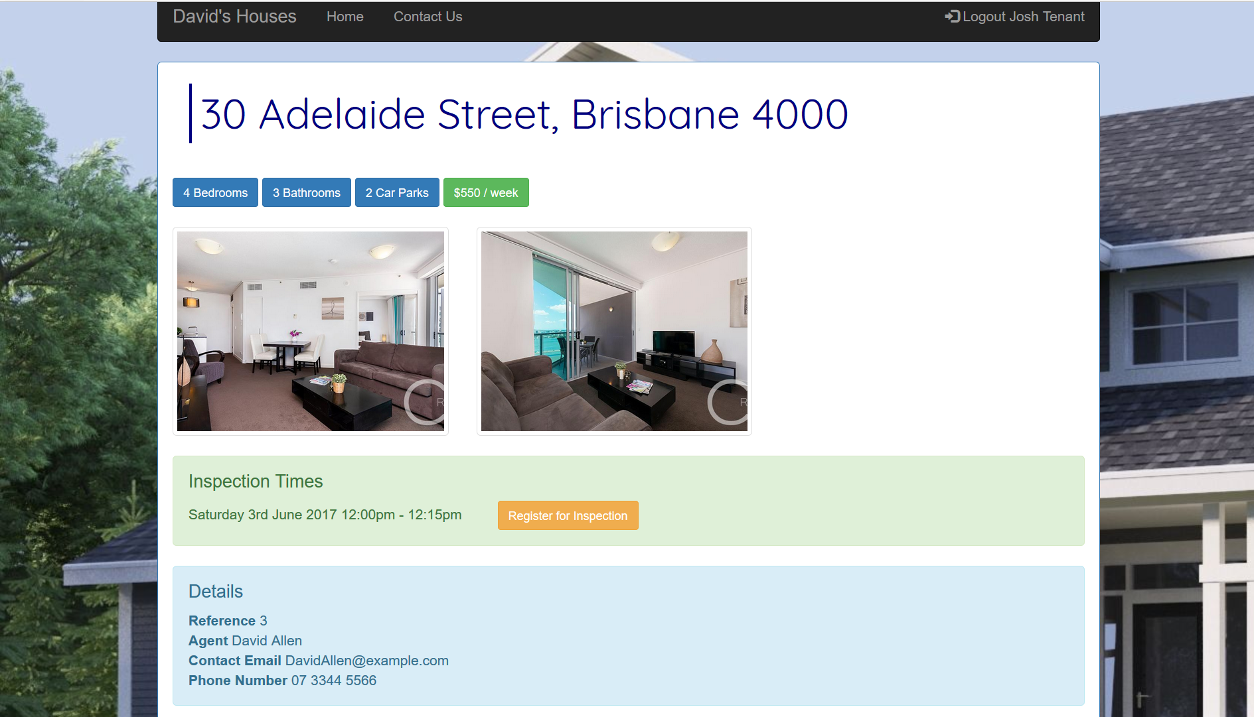

Slide 28


Slide 29
14
Property Photo Gallery
Could
4
•As a prospective tenant, I should be able to see a photo gallery of the rooms in the house so that I can find a property that appeals to more.
Acceptance Criteria
Photos visible on website
Blank if no photos
Notes

Slide 30
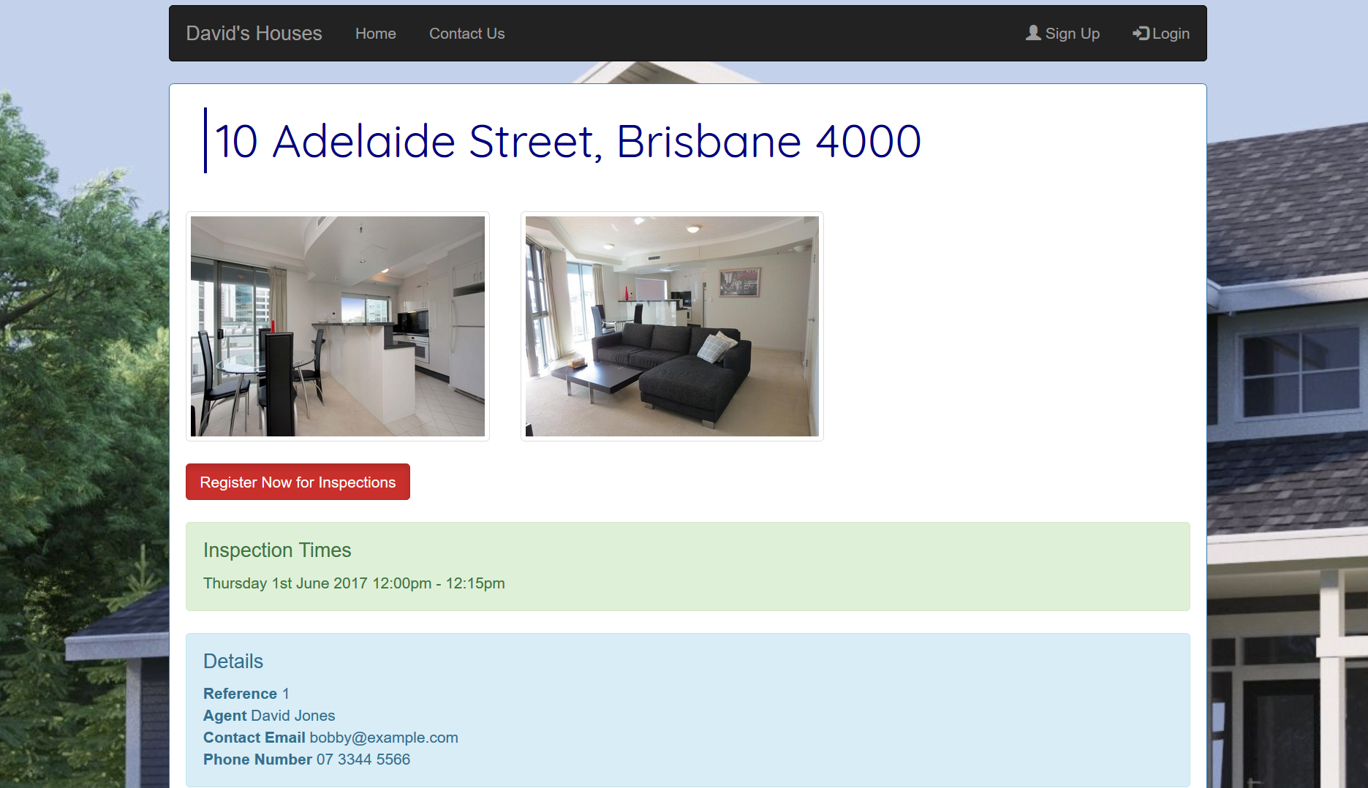

Slide 31
Sprint 2 Release: Part 2
User Registration and Login:
Separating viewable and editable information via user authentication
Story dependencies
S7 Staff Property Allocation
S8 Property Assignment View
S10 Separation of Duties
S15 Property Inspection Request
S16 User Login
S17 User Registration

Slide 32
7
Staff property allocation
Must
1
•As David, I want to be able to allocate a property to a staff member so that they can manage it
Acceptance Criteria
Website shows properties available to allocate
Staff can be allocated to properties
Only David can allocate properties
Notes

Slide 33
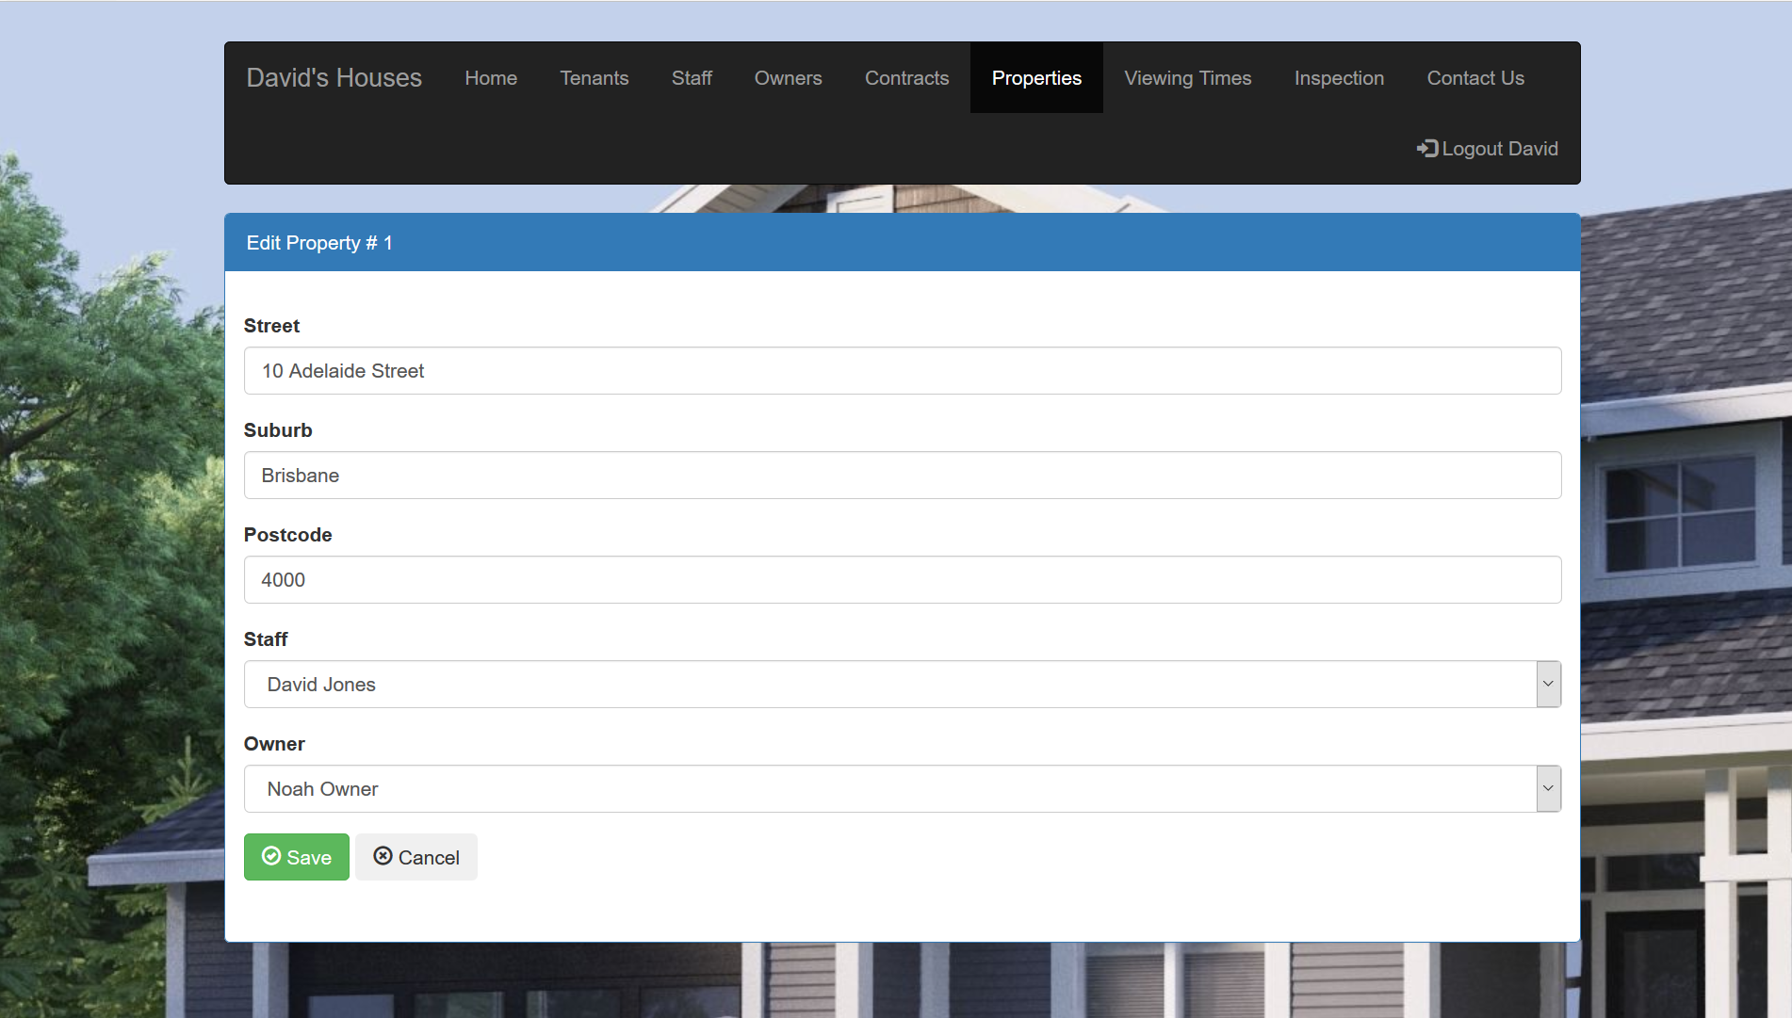

Slide 34
8
Property assignment view
Must
2
•As a staff member, I should be able to view the properties that have been assigned to me so that I can arrange property viewing times
Acceptance Criteria
Staff details page displays allocated properties
Staff can’t modify allocated properties
Blank if no allocated properties
Notes

Slide 35
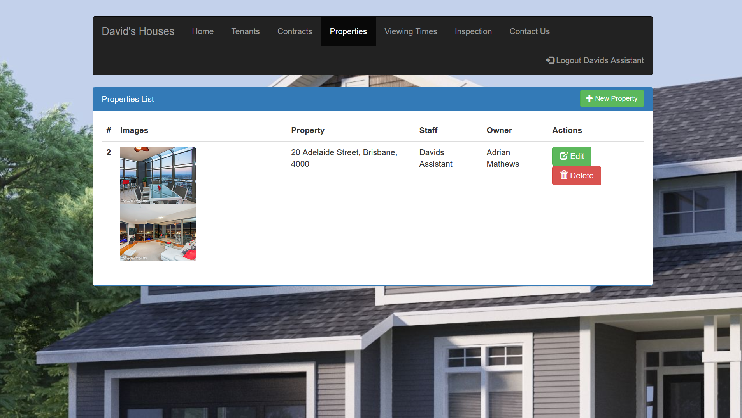

Slide 36
10
Separation of duties
Must
4
•As David, only I can enter/update/delete properties so that I can manage property data
Acceptance Criteria
Only David can enter/update/delete properties
Website records property details
Website displays property details
Required fields can’t be blank
Notes

Slide 38
15
Property Inspection Request
Could
2
•As a prospective tenant, I can request for an inspection and enquire about properties via email to a staff member so that I can liaise with property owners.
Acceptance Criteria
Staff email visible on property page
Staff email can’t be blank
Notes

Slide 39
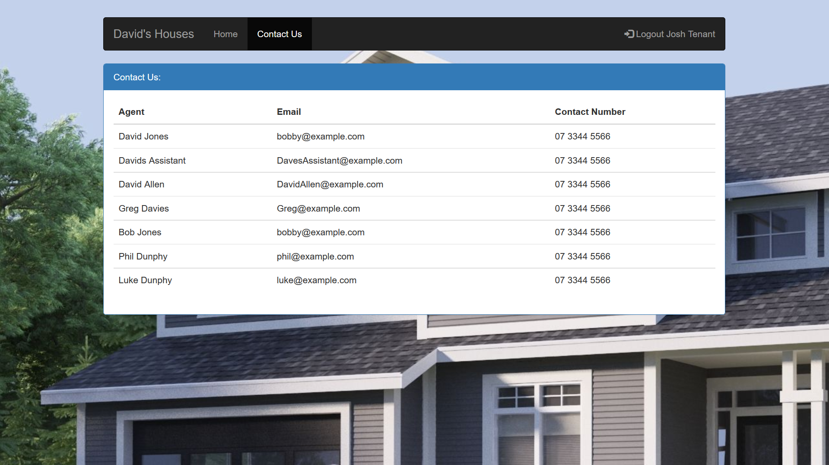

Slide 40
16
User Login
Must
2
• As a user, I need to be able to enter a username/password to log into the website.
Acceptance Criteria
Username must be unique
Website authenticates user details
Required fields can’t be blank
Page displays error if either username or password is incorrect
Notes

Slide 41
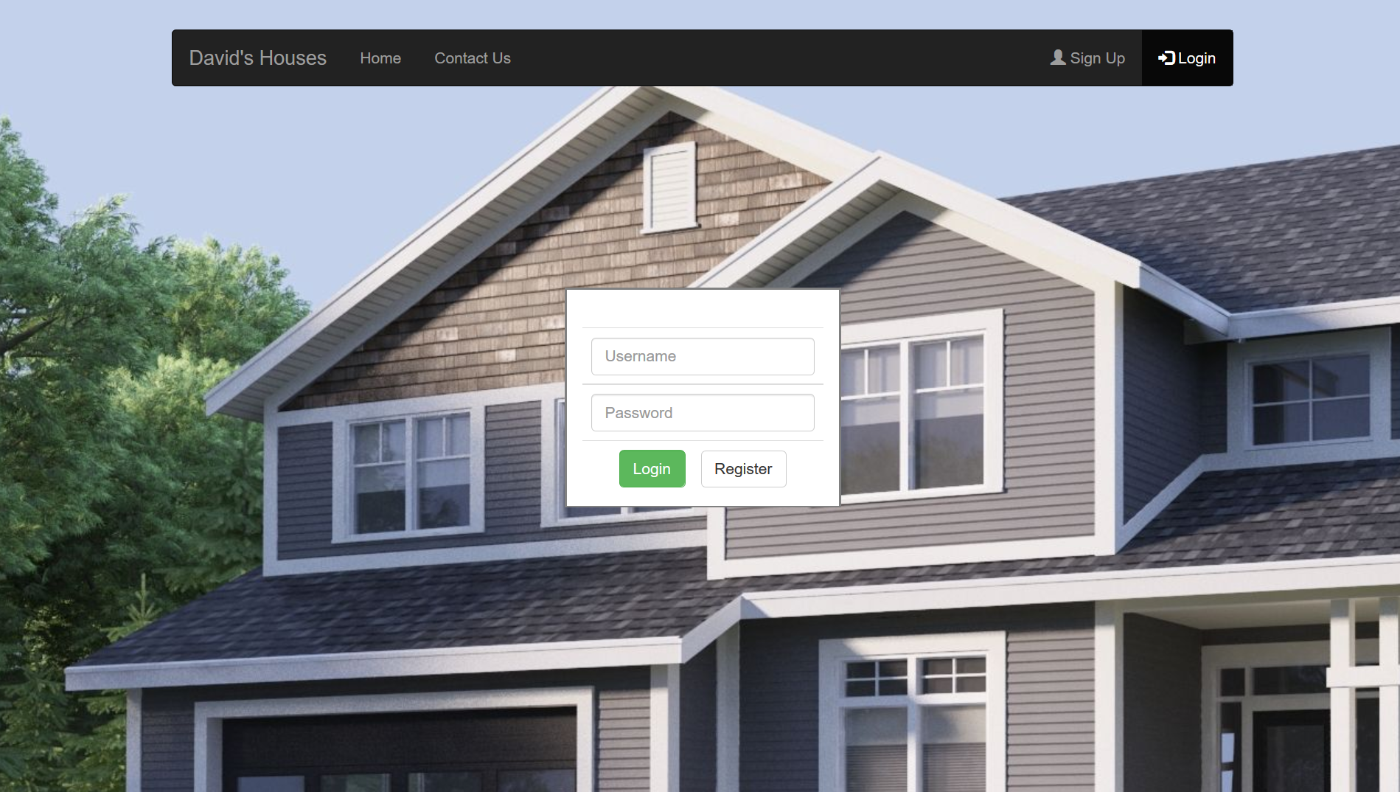

Slide 42
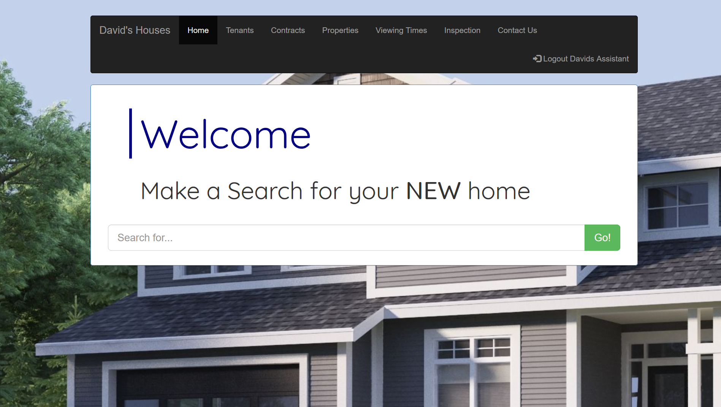

Slide 43
17
User Registration
Must
2
• As a user, I need to be able to enter my details to register an account.
Acceptance Criteria
Username must be unique
Required fields can’t be blank
Notes

Slide 44
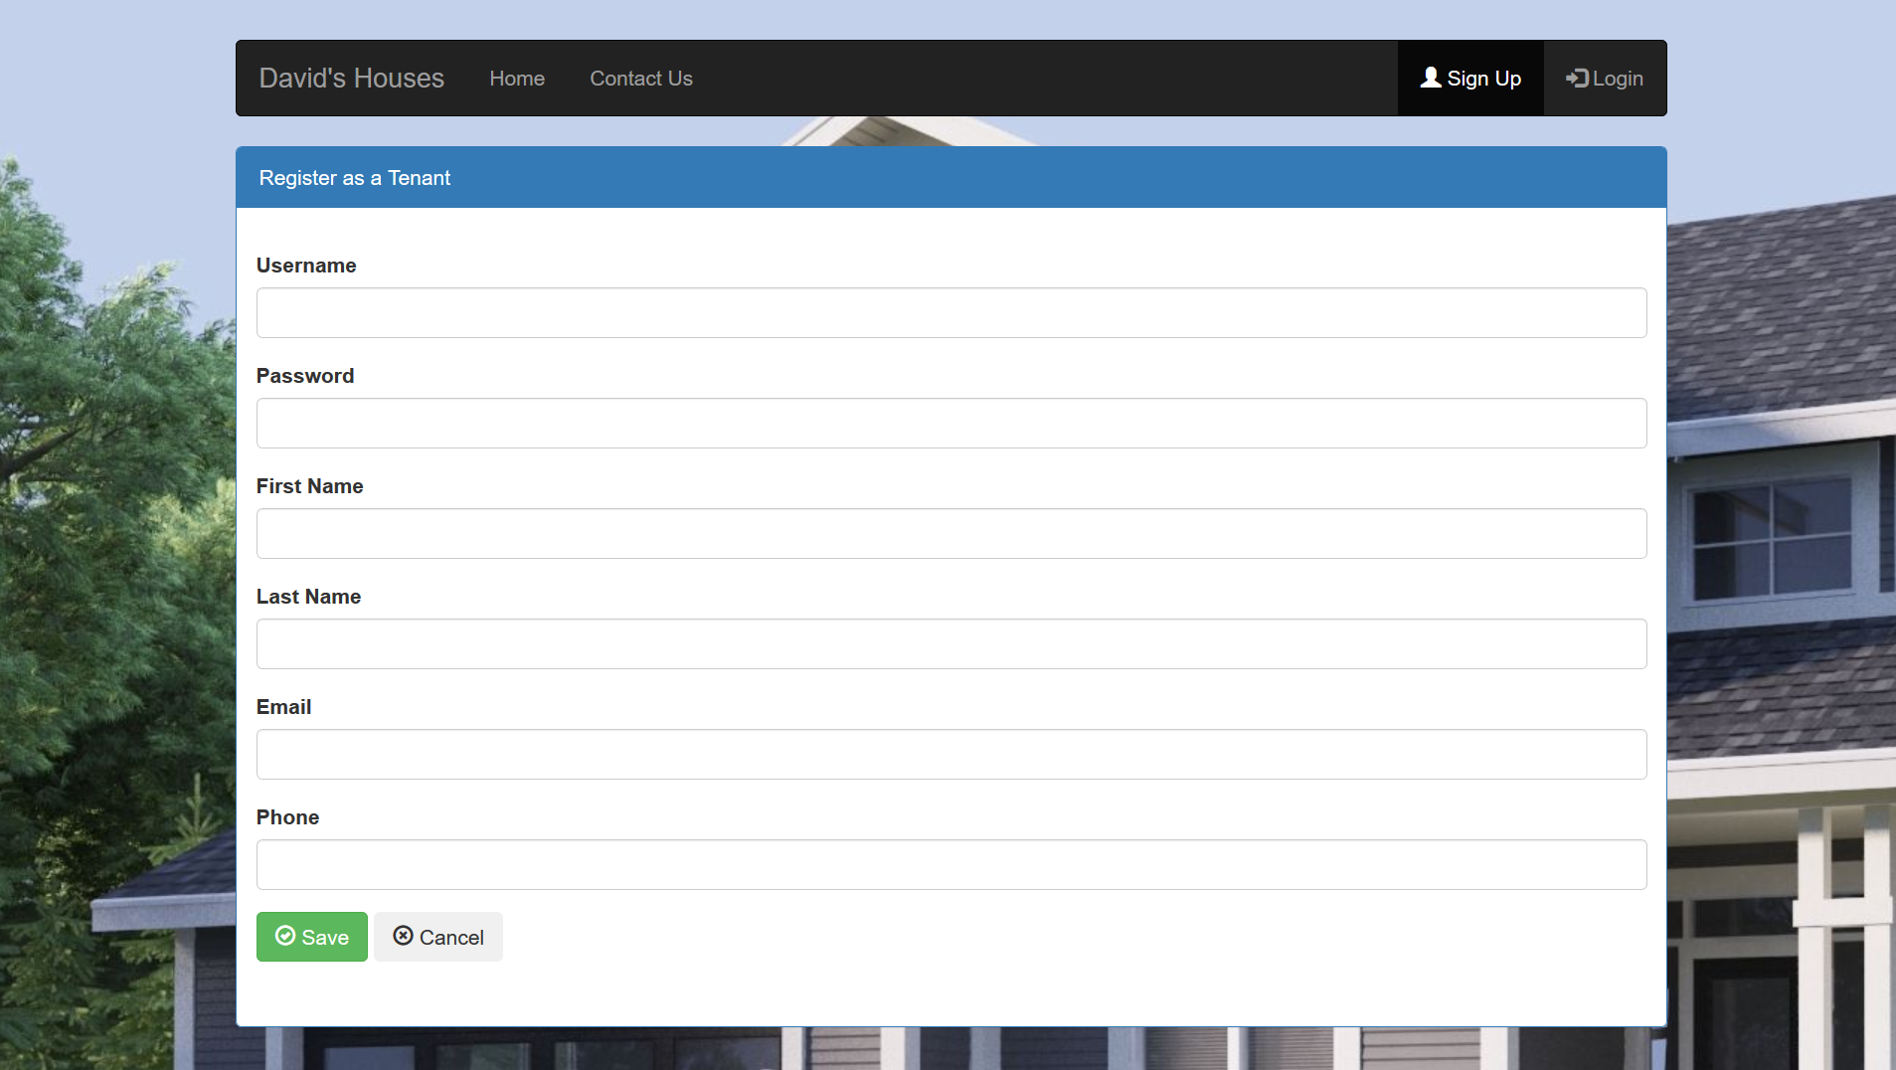

Slide 45
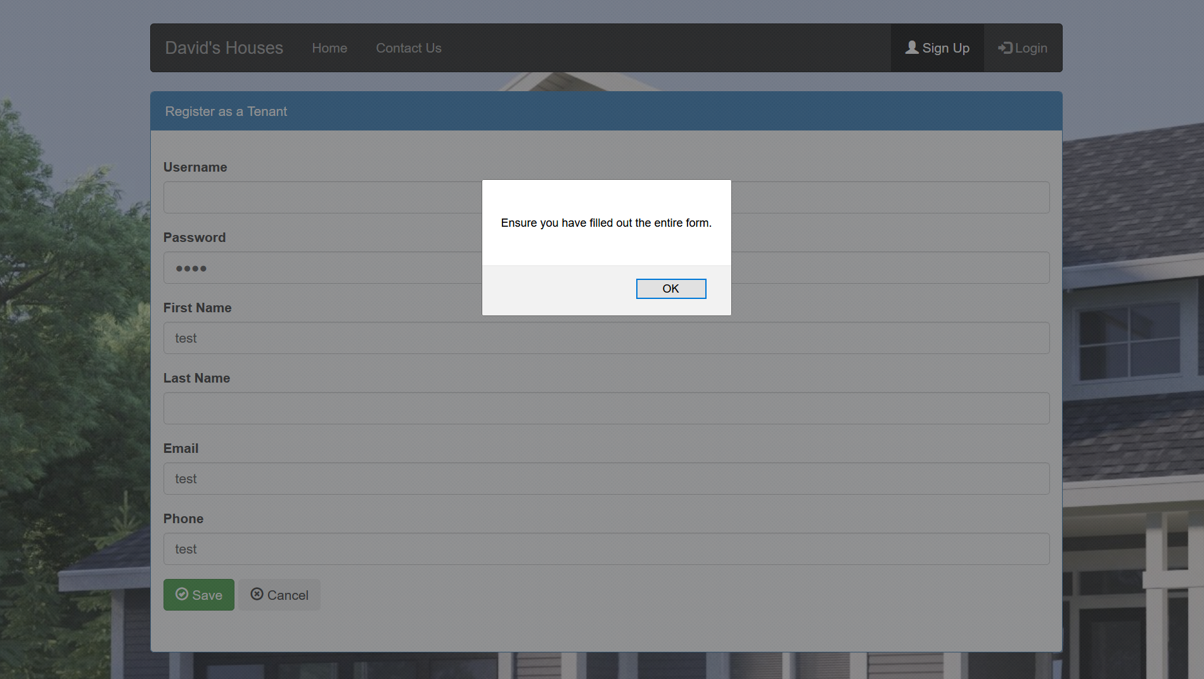

Slide 46
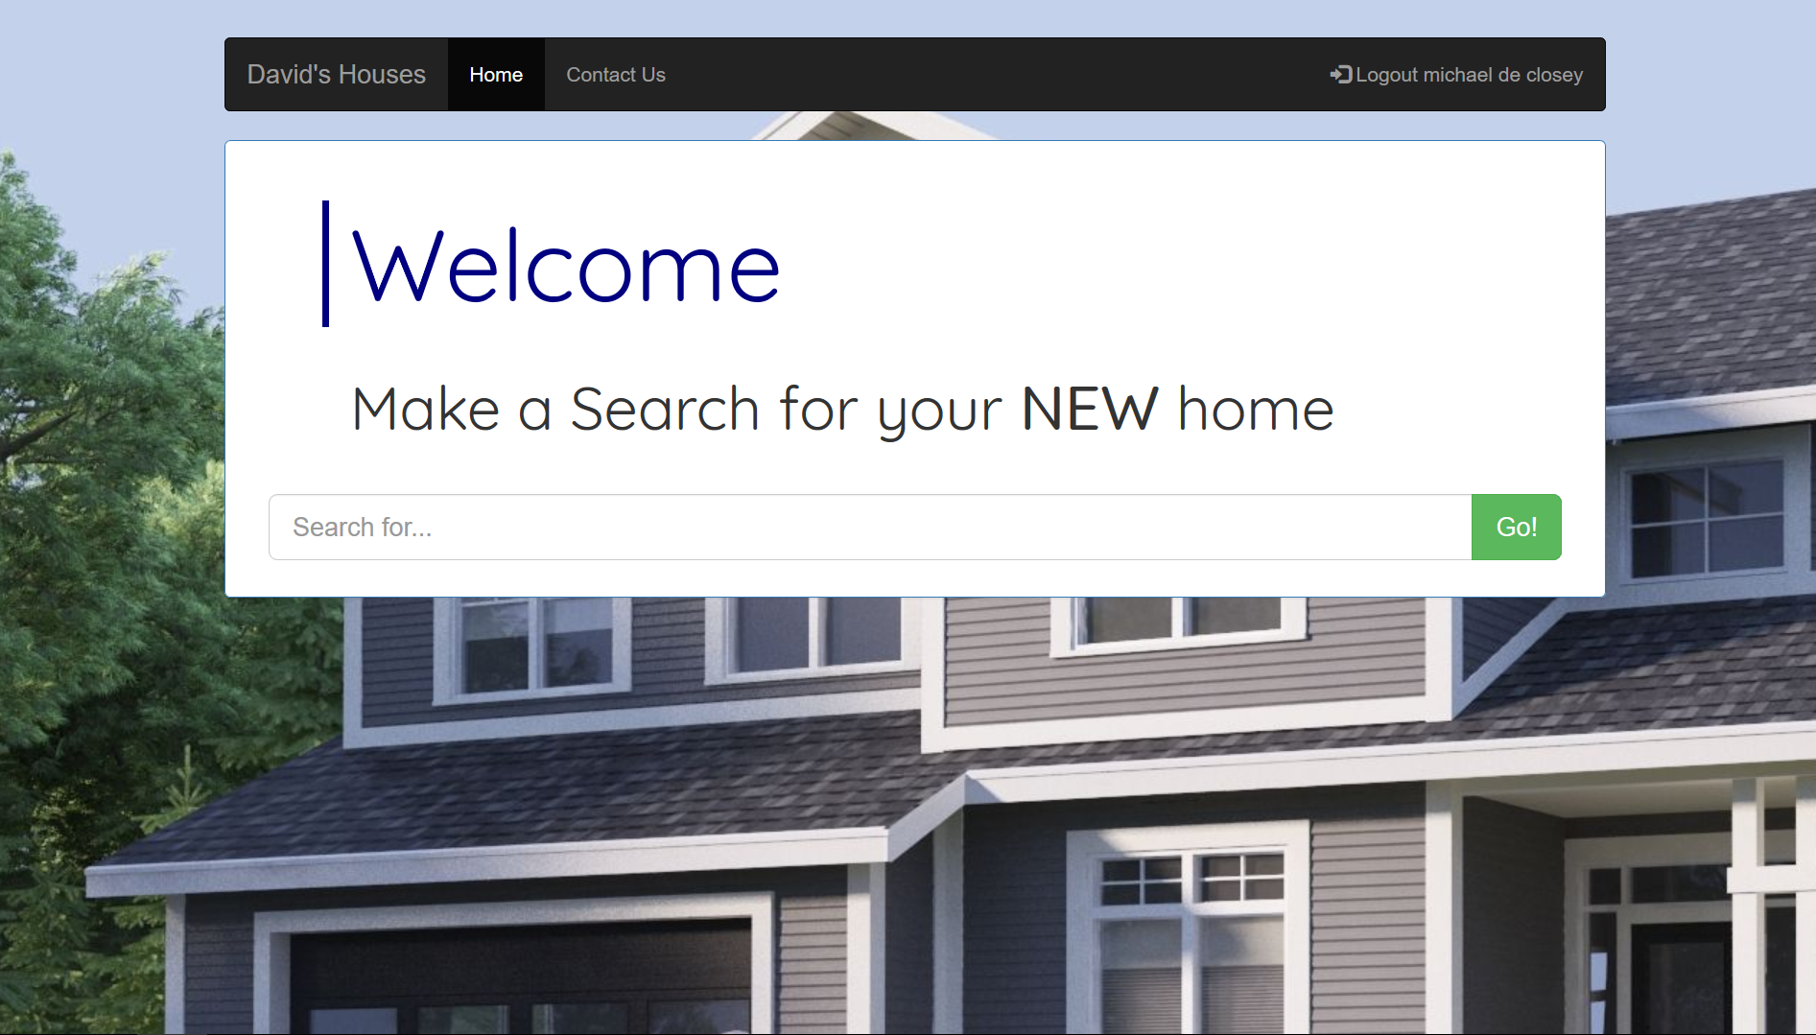

Slide 47
Burndown Charts: Sprint 1

Slide 48
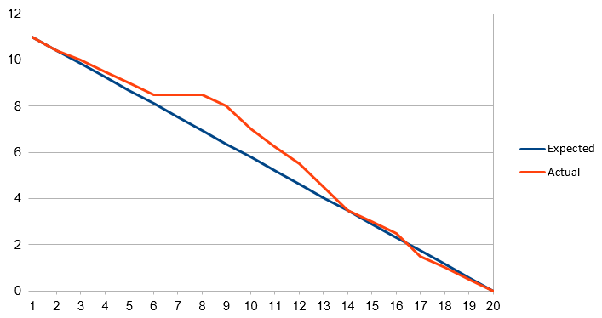
Burndown Charts: Sprint 2

Slide 49
Further Work
Photo Gallery scroll, custom image upload and edit
Advanced search options
Advanced Search Filtering

Slide 50
Questions

